Slide 1
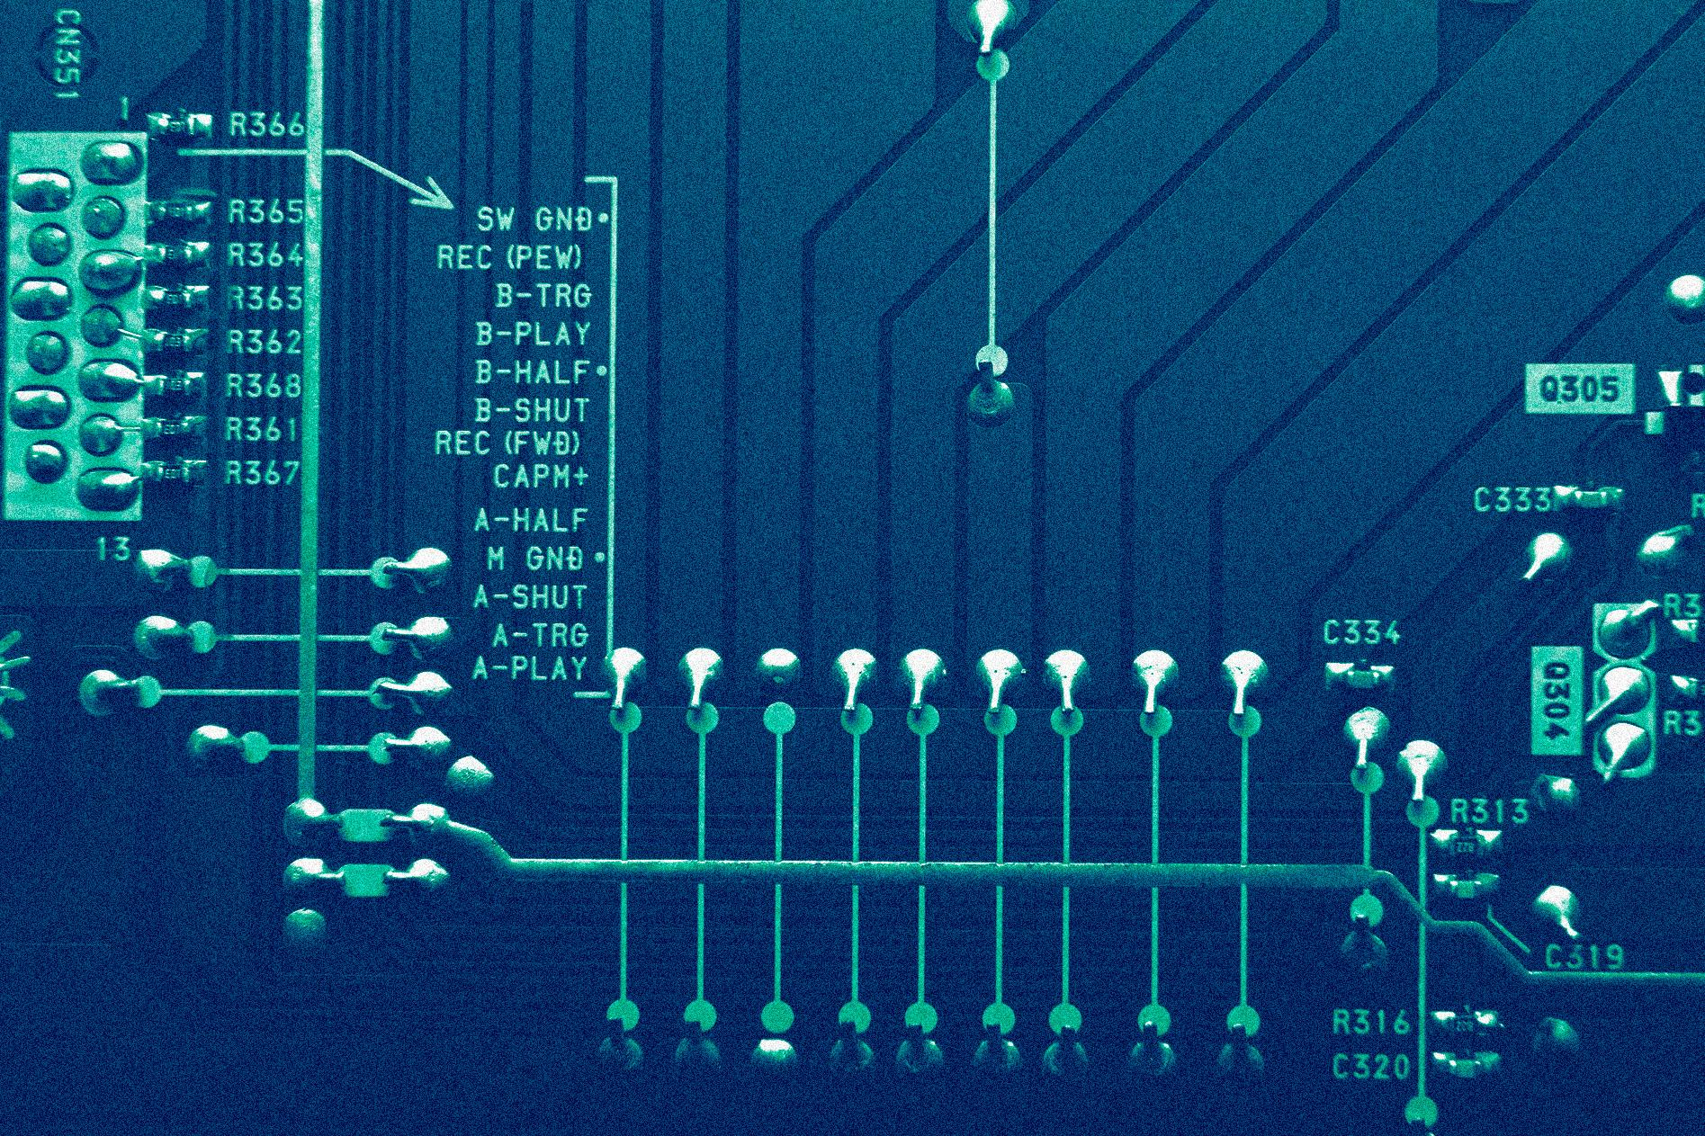
SURVEY OF PROGRAMMING LANGUAGES
INTRO TO
HASKELL
Presented by:
Pao-pao gang

Slide 2
Overview
Quick overview of what we will be presenting…
Intro to Haskell | When it was invented, who invented it, its intended use…
Why Haskell? | Why use Haskell, how it would help you…
Real-world Applications | What is Haskell used for now?
Unique Features | Go over how to run it & go over runnable programs
Resources | If you wanna go crazy with it…
Q&A | Questions? (don’t ask them please)

Slide 3

Your Simple Intro to..
HASKELL
So, about Haskell…
Invented in the late 1980’s by researchers led by Haskell Curry
Created for research and experimentation in functional programming languages
Designed to explore pure functional programming, strong type systems, and lazy evaluation

Slide 4

Why Haskell?
Even though Haskell might seem like a boring language (I don’t blame you), it actually has great use cases that could possibly help you with your next program!
Let’s go over some..

Slide 5
Here are some of the use cases
Strong Typing
Functional Purity
Lazy Evaluation
Helps catch many programming errors at compile-time, reducing the likelihood of runtime errors and making more reliable code
Haskell encourages the use of pure functions, which have no side effects and make code easier to reason about and maintain
Lazy evaluation can lead to more efficient and concise code in certain situations, as it only evaluates expressions when needed

Slide 6
A bit more to persuade you…
Expressive
& Concise
Concurrency & Parallelism
Mathematical Foundations
Haskell's expressive syntax allows you to write code that is both concise and elegant, reducing boilerplate and making your codebase more readable.
Haskell's pure functional nature makes it well-suited for concurrent and parallel programming, allowing you to take full advantage of multi-core processors.
Haskell has strong ties to mathematical concepts, making it suitable for applications involving complex mathematical computations.

Slide 7
Hold on…let me cook
Research & Experimentation
Community & Libraries
Learning Experience
If you're interested in programming language design, Haskell provides a platform for experimenting with new language features and paradigms
Haskell has an active and supportive community, and there is a growing ecosystem of libraries and tools available for various tasks.
Learning Haskell can expand your programming horizons by exposing you to functional programming concepts and different ways of thinking about programming problems.

Slide 8
Real World Applications
01
02
03
04
Financial Services
Used for risk analysis, trading algorithms, and quantitative modeling
Language Development
Utilized to build compilers and interpreters
Cryptographic Software
Ensures correctness and security in cryptographic applications
Aerospace
Trajectory analysis, flight control systems, and simulations

Slide 9
Let’s Run
HASKELL

Slide 10
Helpful Resources
Haskell.org
Learn You a Haskell!
Haskell Playlist
https://www.haskell.org/
http://learnyouahaskell.com/chapters
https://youtube.com/playlist?list=PLe7Ei6viL6jGp1Rfu0dil1JH1SHk9bgDV&si=yNGV3JRD1Yo9jRtN

Slide 11
Thanks For Listening!
Any Questions?

